Slide 1

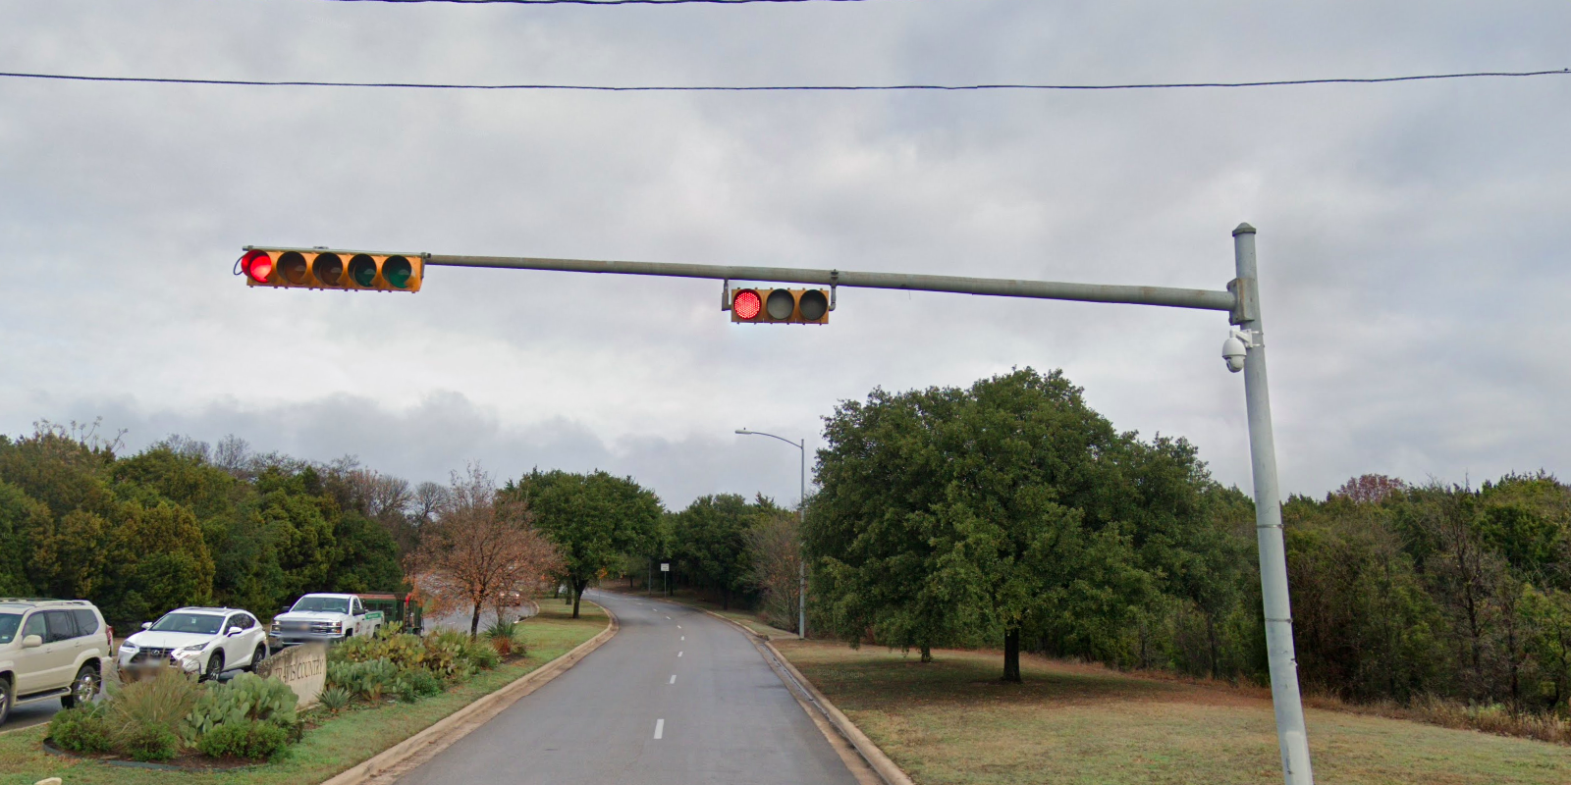
Austin Transportation Department Signs Work Orders
Created By: Susanne Gov Created Date: 2020-05-21 Location Name: SOUTHWEST PKWY / REPUBLIC OF TEXAS BLVD Intersection ID: 5147905 Cardinal Direction: N
Sign Type | Install/Remove

Slide 2
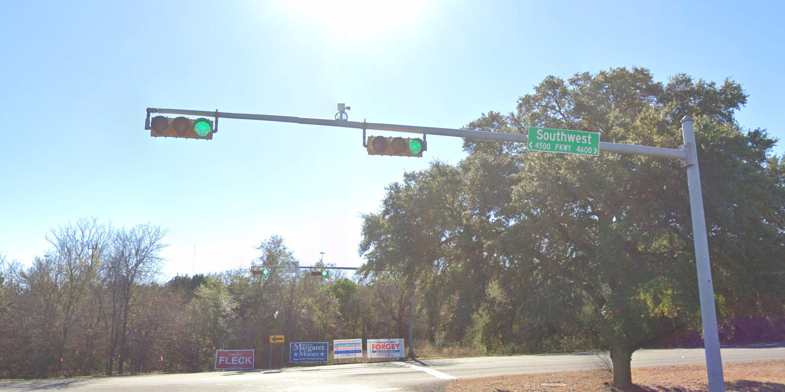
Austin Transportation Department Signs Work Orders
Created By: Susanne Gov Created Date: 2020-05-21 Location Name: SOUTHWEST PKWY / REPUBLIC OF TEXAS BLVD Intersection ID: 5147905 Cardinal Direction: S
Sign Type | Install/Remove
Street Name Sign | Install

Slide 3
Austin Transportation Department Signs Work Orders
Created By: Susanne Gov Created Date: 2020-05-21 Location Name: SOUTHWEST PKWY / REPUBLIC OF TEXAS BLVD Intersection ID: 5147905 Cardinal Direction: E
Sign Type | Install/Remove

Slide 4
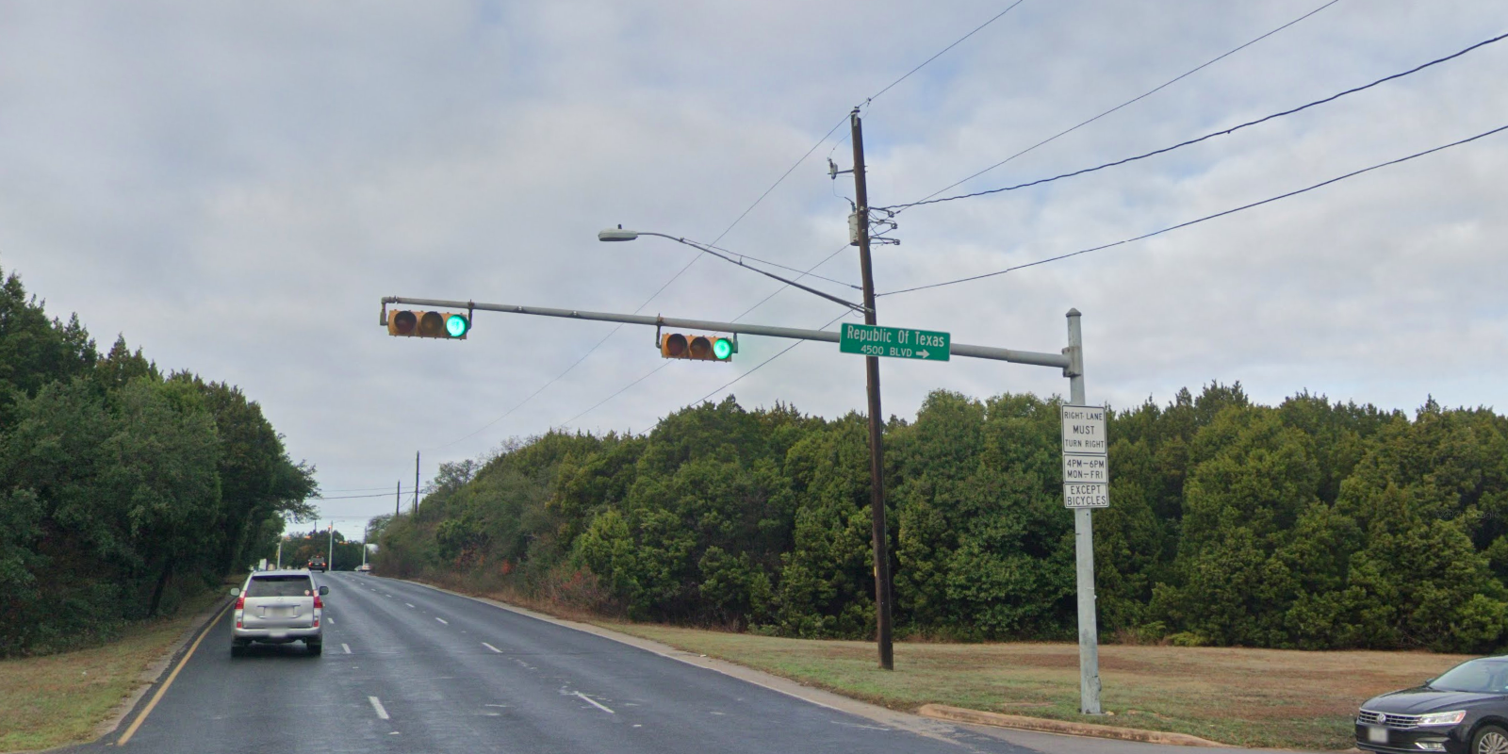
Austin Transportation Department Signs Work Orders
Created By: Susanne Gov Created Date: 2020-05-21 Location Name: SOUTHWEST PKWY / REPUBLIC OF TEXAS BLVD Intersection ID: 5147905 Cardinal Direction: W
Sign Type | Install/Remove
Street Name Sign | Install
Right Turn Must Turn Right | Install
Time Schedule | Install
Except Bicycles | Install

